Slide 1
Bayesian Strategies for Multi-study Integration using Biological Hierarchies
Bayesian Concepts and Models for Multi-omics and Multi-study Analyses
2022 ISBA World Meeting
Rupam Bhattacharyya
June 29, 2022

Slide 2



The Team
Rupam Bhattacharyya
Dr. Nicholas Henderson
Prof. Veera Baladandayuthapani

Slide 3
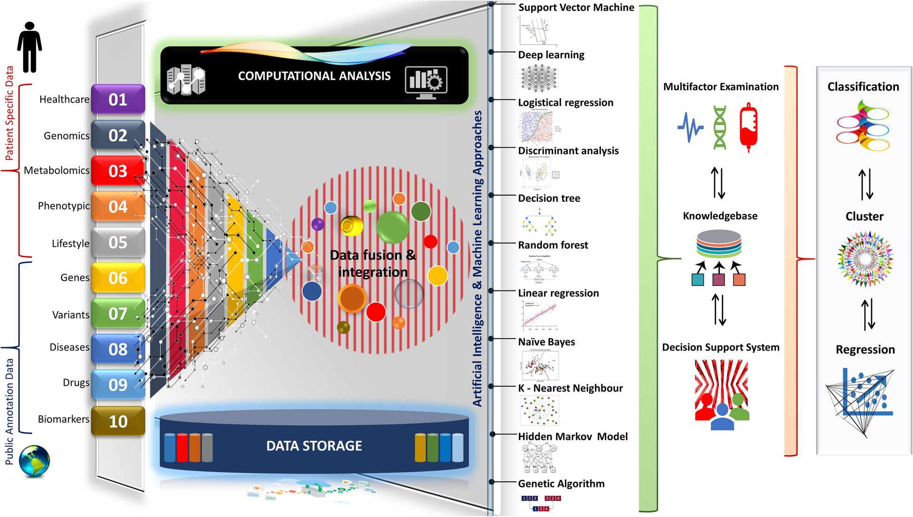
Precision Medicine
Ahmed 2020, Human Genomics

Slide 4
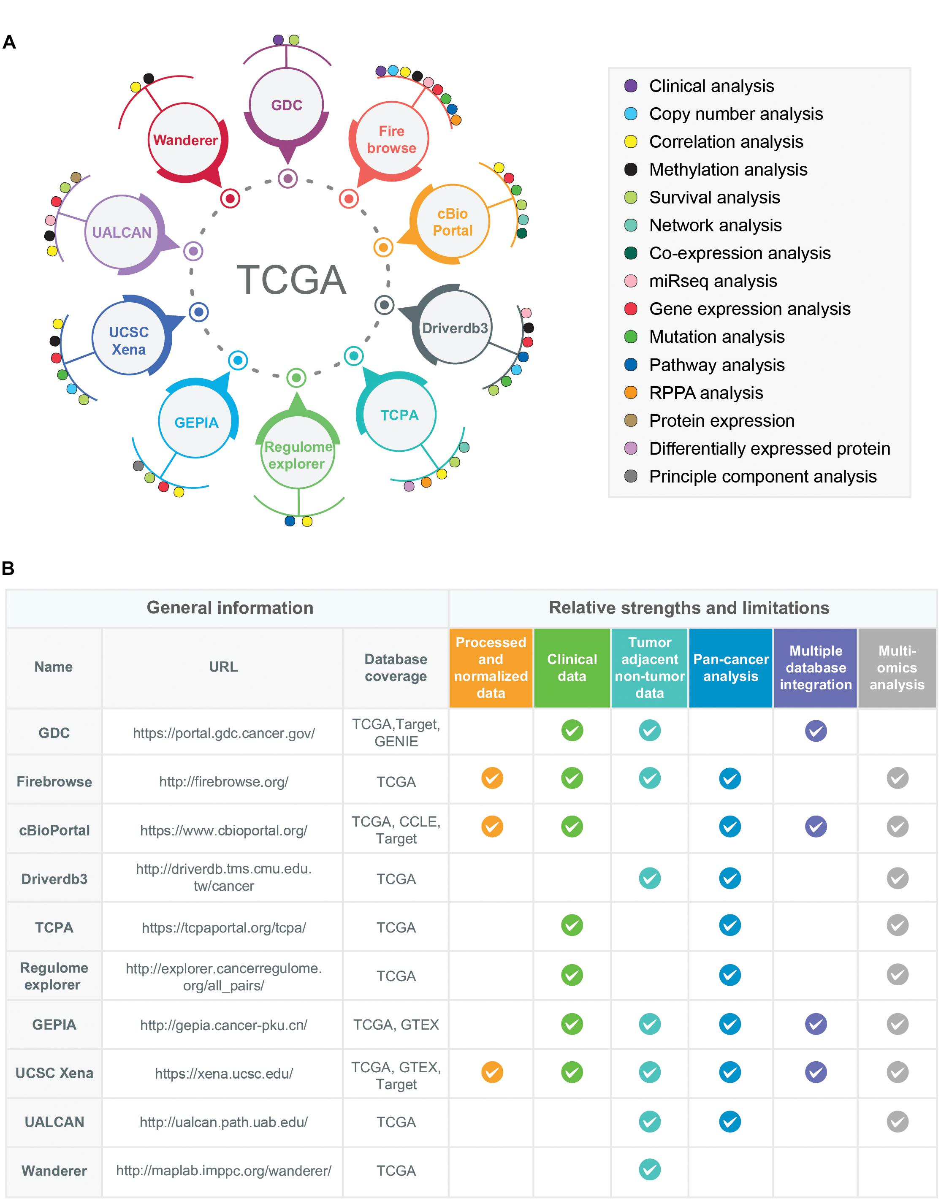
Multi-{Omics,System} Databases
Das et al. 2020, Frontiers in Genetics

Slide 5
Biological Background
Some disease setting.
Cancer in our case.
Some outcome of interest.
Survival, clinical phenotype, …
A pool of genes/proteins.
Question of association.
Some relevant knowledge about the functional cellular role of the biomarkers.

Slide 6
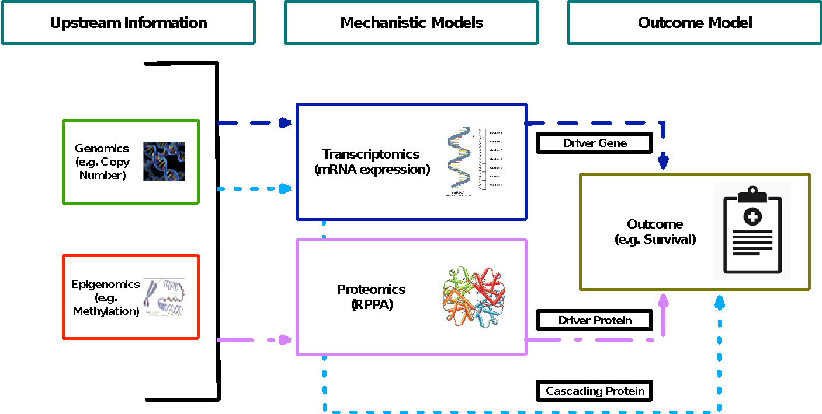
Biological Background

Slide 7
Biological Background
Information paths:
Regulations unique at transcript/protein levels. (Drivers)
Significant relationship between the genomic/epigenomic event and their resulting gene expression. (Functional drivers)
Regulations transitioning through different omics levels. (Cascades)
We follow the biological idea of drivers as described in Gevaert et al. 2013, Interface Focus, and that of cascades as in Song et al. 2019, Mol. Cel. Proteomics.

Slide 8
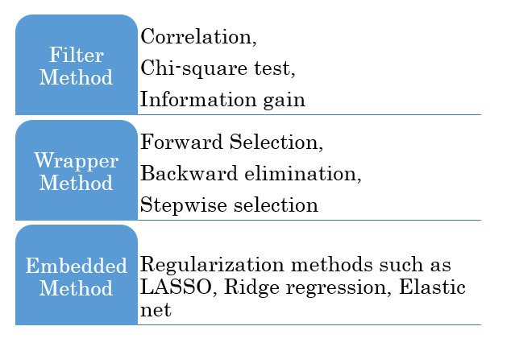
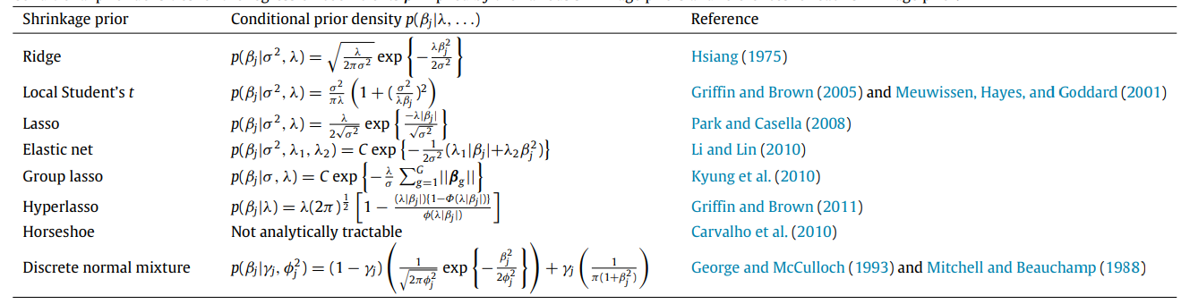
General Problem
A standard regression-type setting.
Some outcome Y, some covariates X₁, X₂, …
Interest in associations between X, Y.
Question of selection.
Or you could use a selection prior (like spike-and-slab).
https://www.datasciencesmachinelearning.com/2019/10/feature-selection-filter-method-wrapper.html
van Erp et al. 2019, Journal of Mathematical Psychology

Slide 9
General Problem
Some prior information available on each covariate.
Maybe some scalar metric from previous models.
Has a certain directionality of evidence.
Absence doesn’t mean futility.
How to inform the model of such data?
Most selection/shrinkage approaches haven’t explored this until very recently.
Some discrete information could be used (e.g. grouped LASSO).

Slide 10
Modeling Idea
Multilevel modeling approach.
Mechanistic models that learn about ‘importance’ of genes/proteins.
An outcome model that incorporates such knowledge to improve selection.

Slide 11


Mechanistic Models
Notations: C - copy number alteration, M - DNA methylation, G - mRNA expression, P - proteomics.
Driver Gene
Driver Protein
Cascading Protein

Slide 12
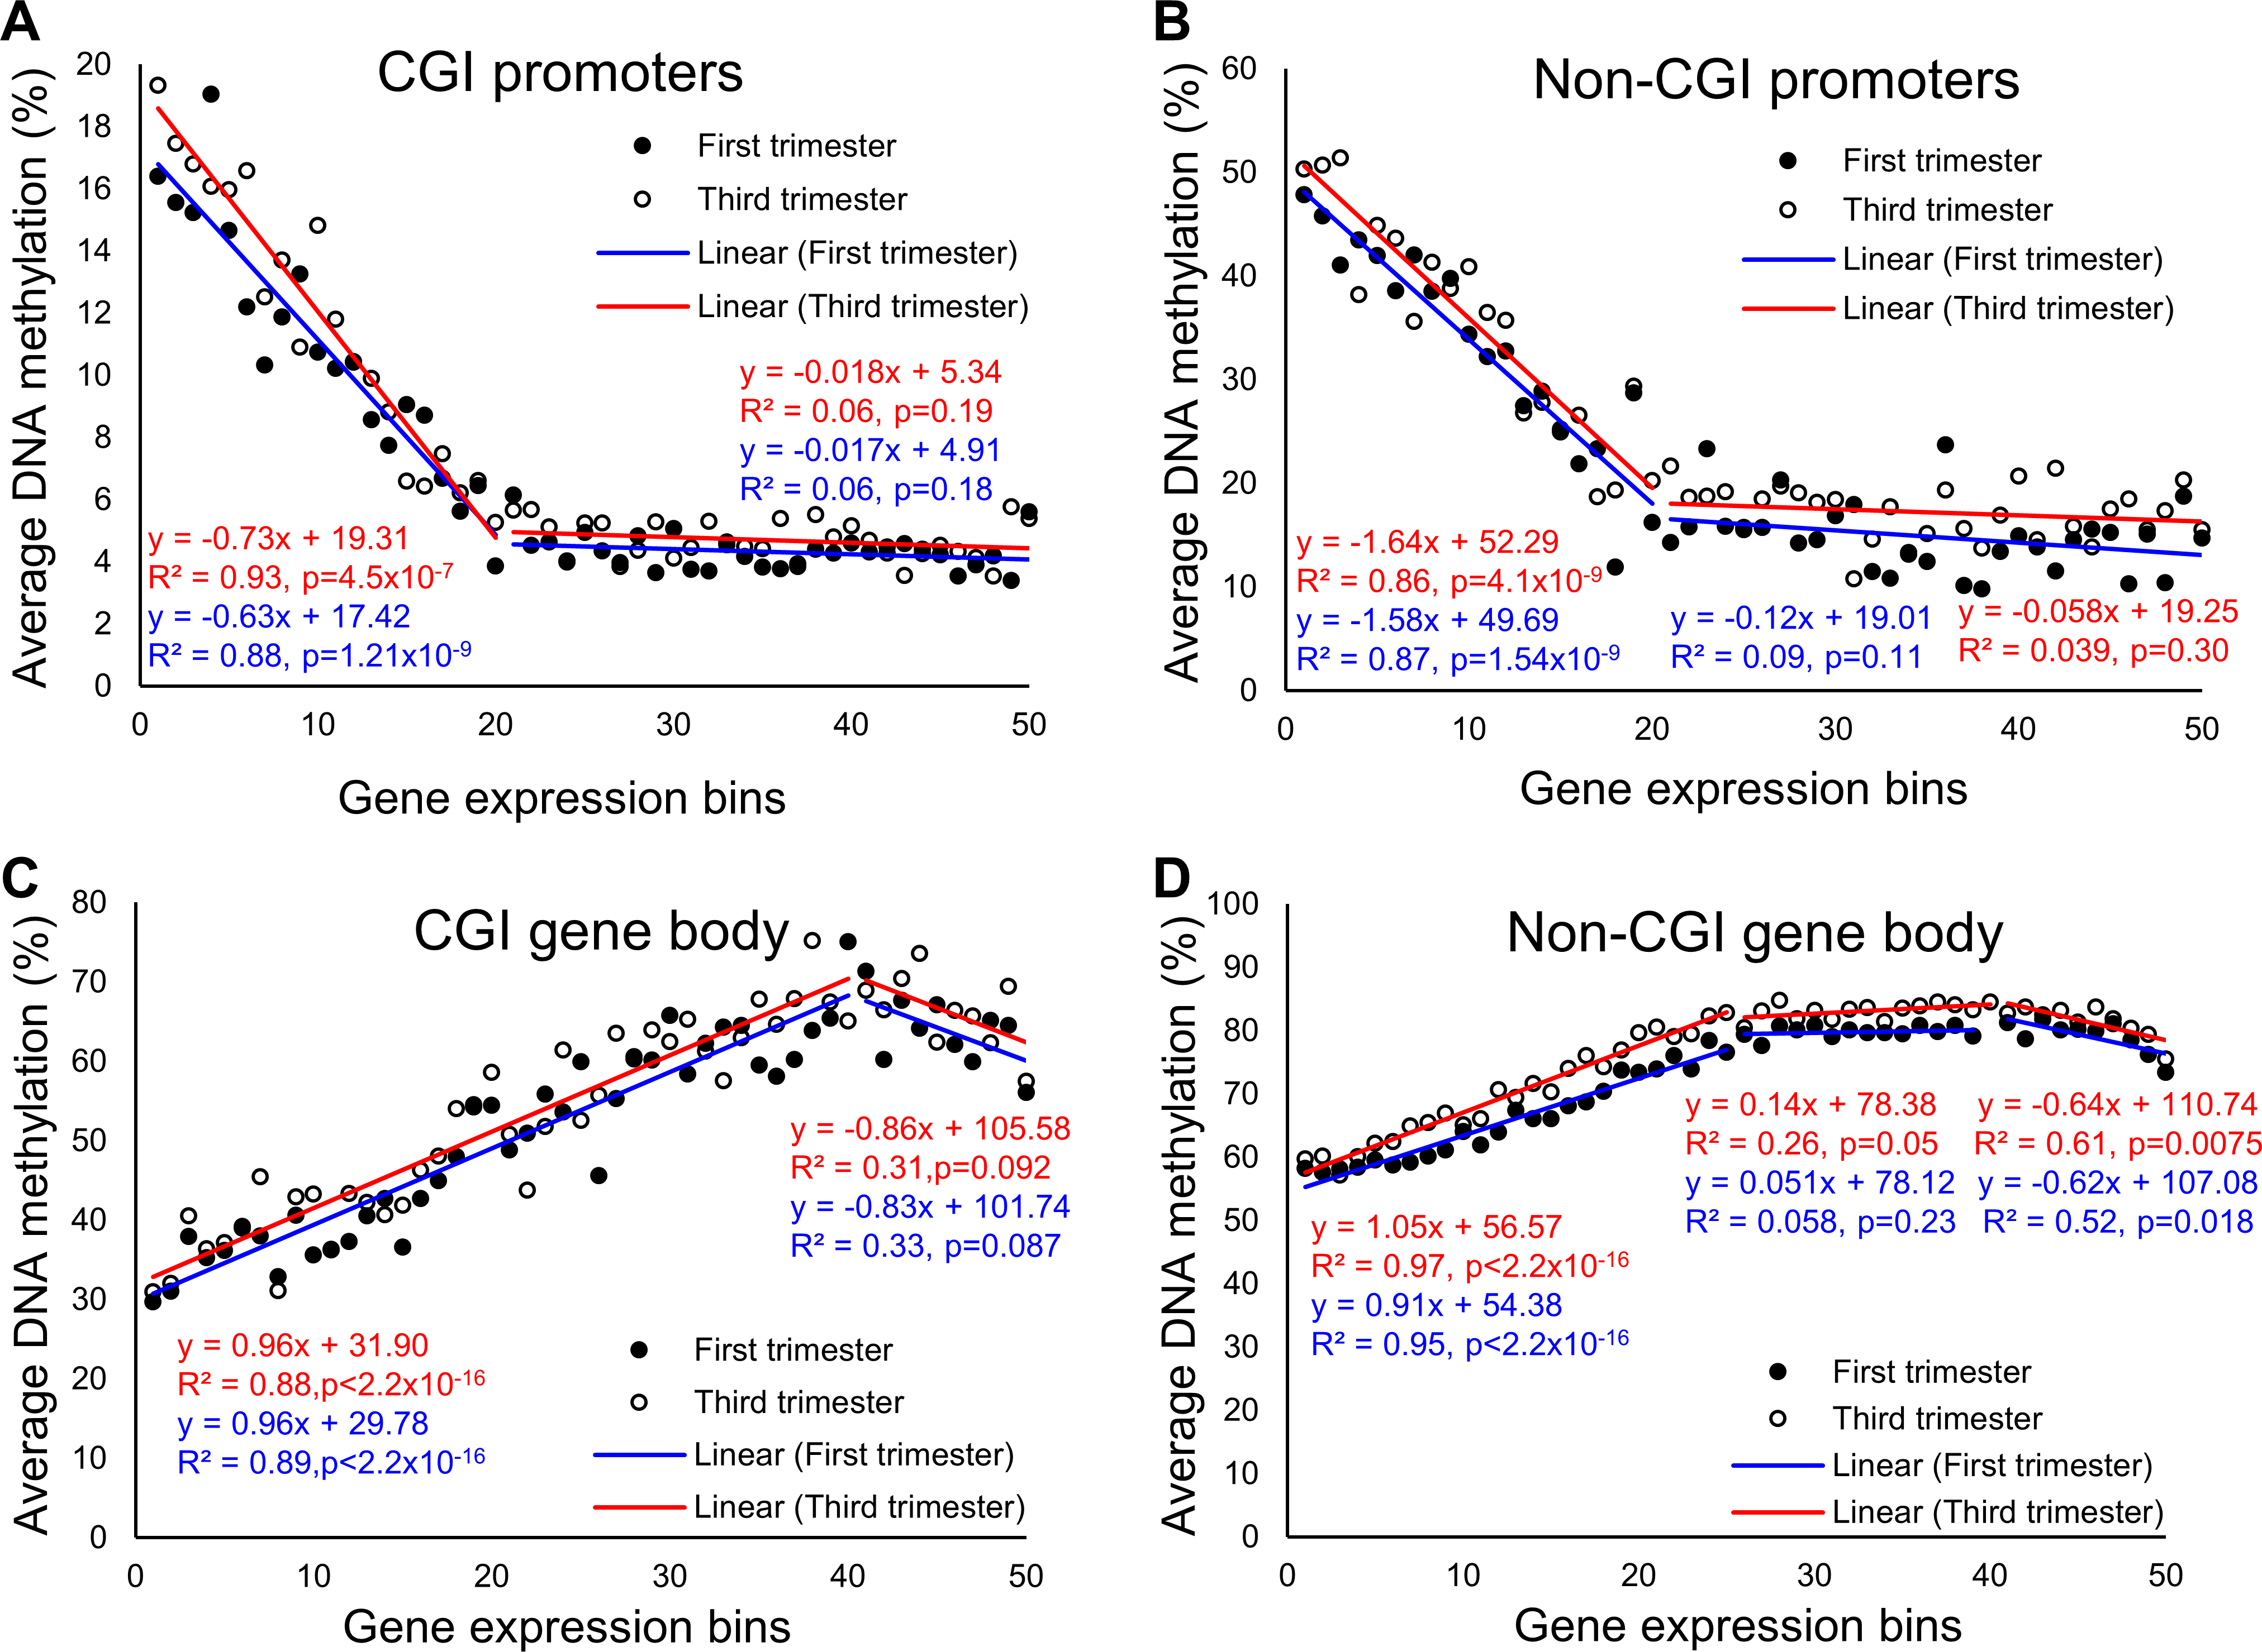
Mechanistic Models
1 model for each gene, 2 for each protein.
Separate utility of each model?
Computationally simple - can be parallelized.
What f’s should we choose?
Linear models would be simplest.
Prior literature available.
Cellular activities, however, aren’t necessarily based on linear associations.
Lim et al. 2017, PLOS One

Slide 13

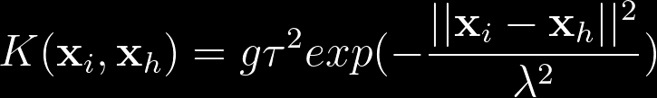
Mechanistic Models
We use Gaussian processes (GPs).
Global model metric for now.
Use Bayes factors to quantify evidence.
Can use additive GPs to deconvolve the components.

Slide 14
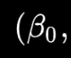
Outcome Model
Evidences go into the priors for these parameters

Slide 15


Outcome Model
Comes from the Bayes factors
Advantages:
Allows the user to incorporate any form of evidence.
Only requires some summary statistics.
Can control the impact of evidence.
Can combine multiple evidences.

Slide 16
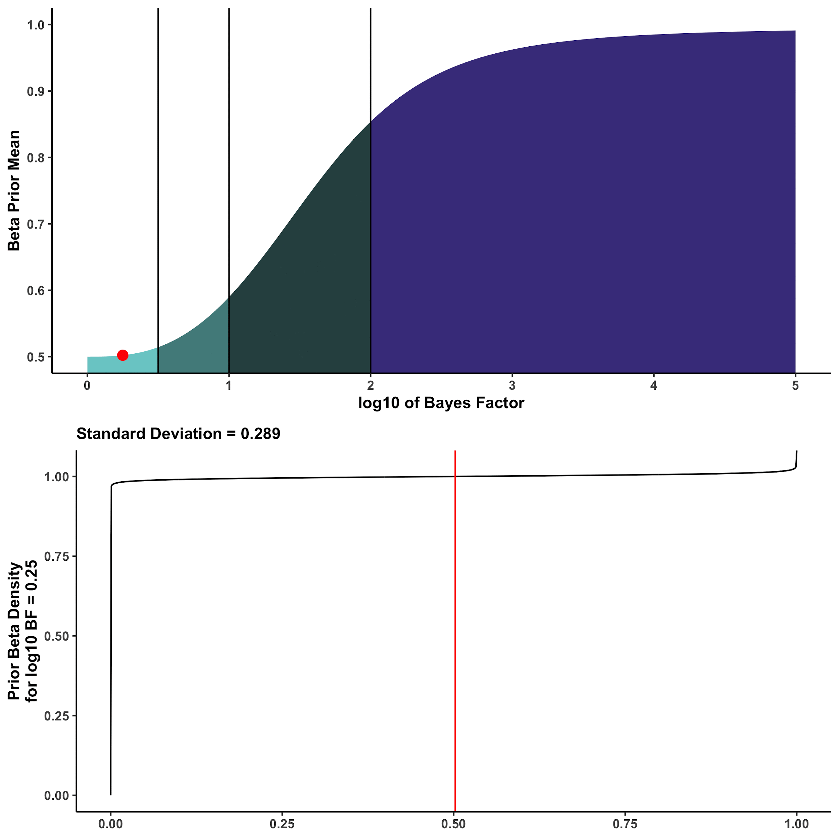
Calibration Map

Slide 17
Computation
Outcome type:
Continuous/survival/…
Computation:
Full MCMC.
Easy to implement (rjags works fine).
Exponentially slower with larger panel.
RCPP doesn’t help too much.
Selection-only MCMC.
Integrate everything else out other than the selection indicators.
Closed form posterior is gettable easily.
Way faster even if written in R.
E-M based Bayesian variable selection (EMVS).
Based on Rockova and George 2014, JASA.
Easy to derive for all our cases.
Fastest option with caveats.

Slide 18
Model Fitting
Full MCMC
Exact Posterior
Selection-only MCMC
Faster Computation
E-M based BVS

Slide 19
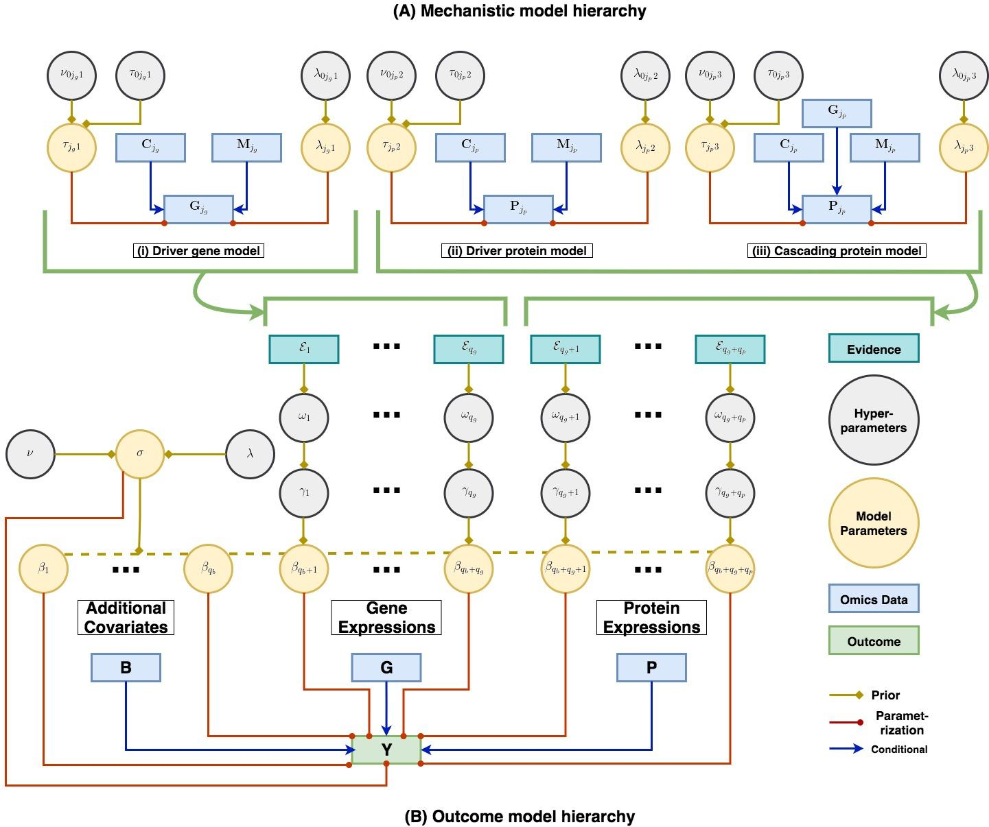
Full Model

Slide 20
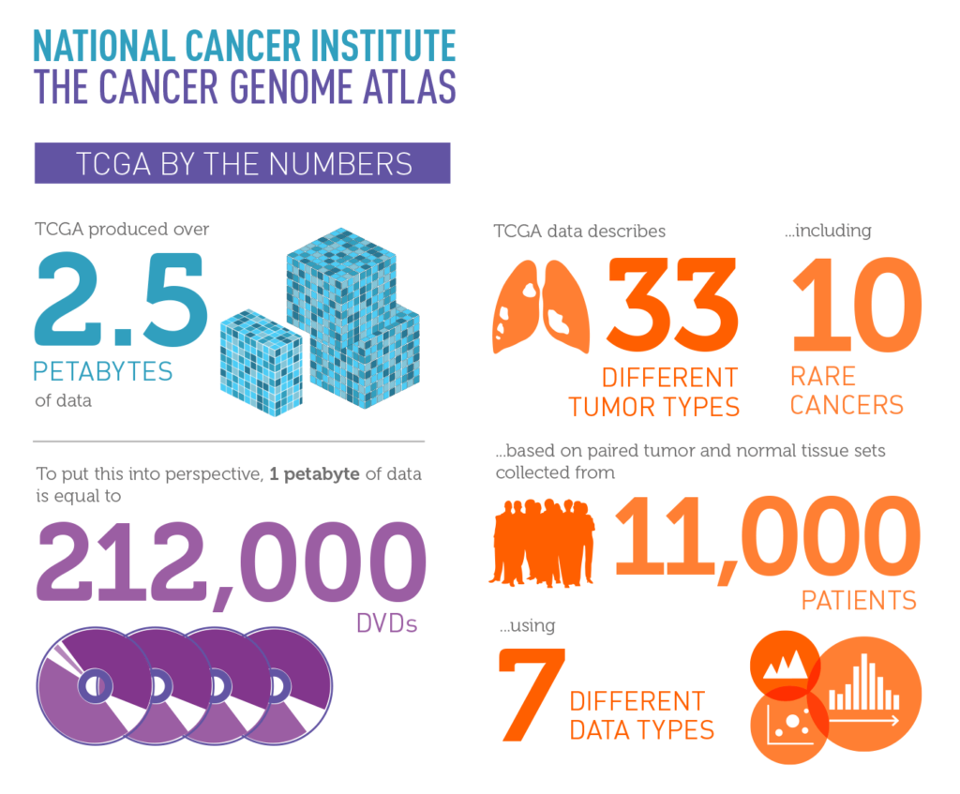
TCGA

Slide 21
Simulation
Continuous outcome.
Selection-only MCMC version.
Covariates picked up from TCGA cancers.
Fix a TCGA cancer.
Fix covariate matrix from real data.
Pick up effect sizes from an uncalibrated variable selection model.
Generate outcome based on it.

Slide 22
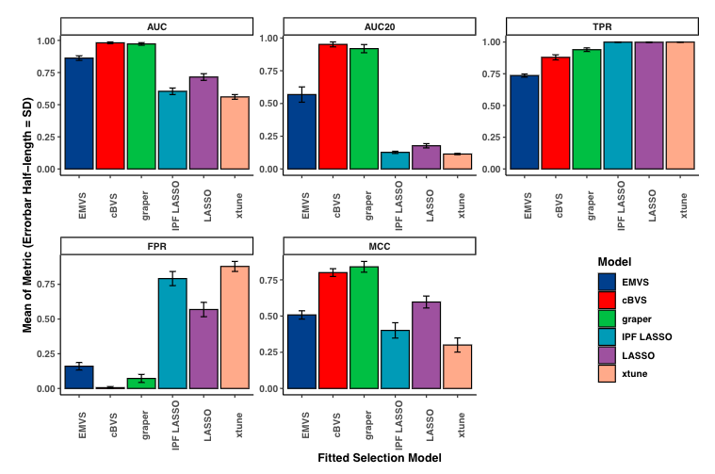
Simulation
Calibrated methods mostly do well.
cBVS does well across all metrics.
Performance preserved in other small-sample scenarios.

Slide 23
Pan-cancer Analysis
14 TCGA cancers classified into four groups.
Pan-gynae: breast invasive carcinoma (BRCA), cervical squamous cell carcinoma and endocervical adenocarcinoma (CESC), ovarian serous cystadenocarcinoma (OV), uterine corpus endometrial carcinoma (UCEC), uterine carcinosarcoma (UCS).
Pan-kidney: kidney chromophobe (KICH), kidney renal clear cell carcinoma (KIRC), kidney renal papillary cell carcinoma (KIRP).
Pan-squamous: esophageal carcinoma (ESCA, squamous), head and neck squamous cell carcinoma (HNSC), lung squamous cell carcinoma (LUSC).
Pan-GI: colon and rectum adenocarcinoma (CORE), esophageal carcinoma (ESCA, adeno), stomach adenocarcinoma (STAD).

Slide 24
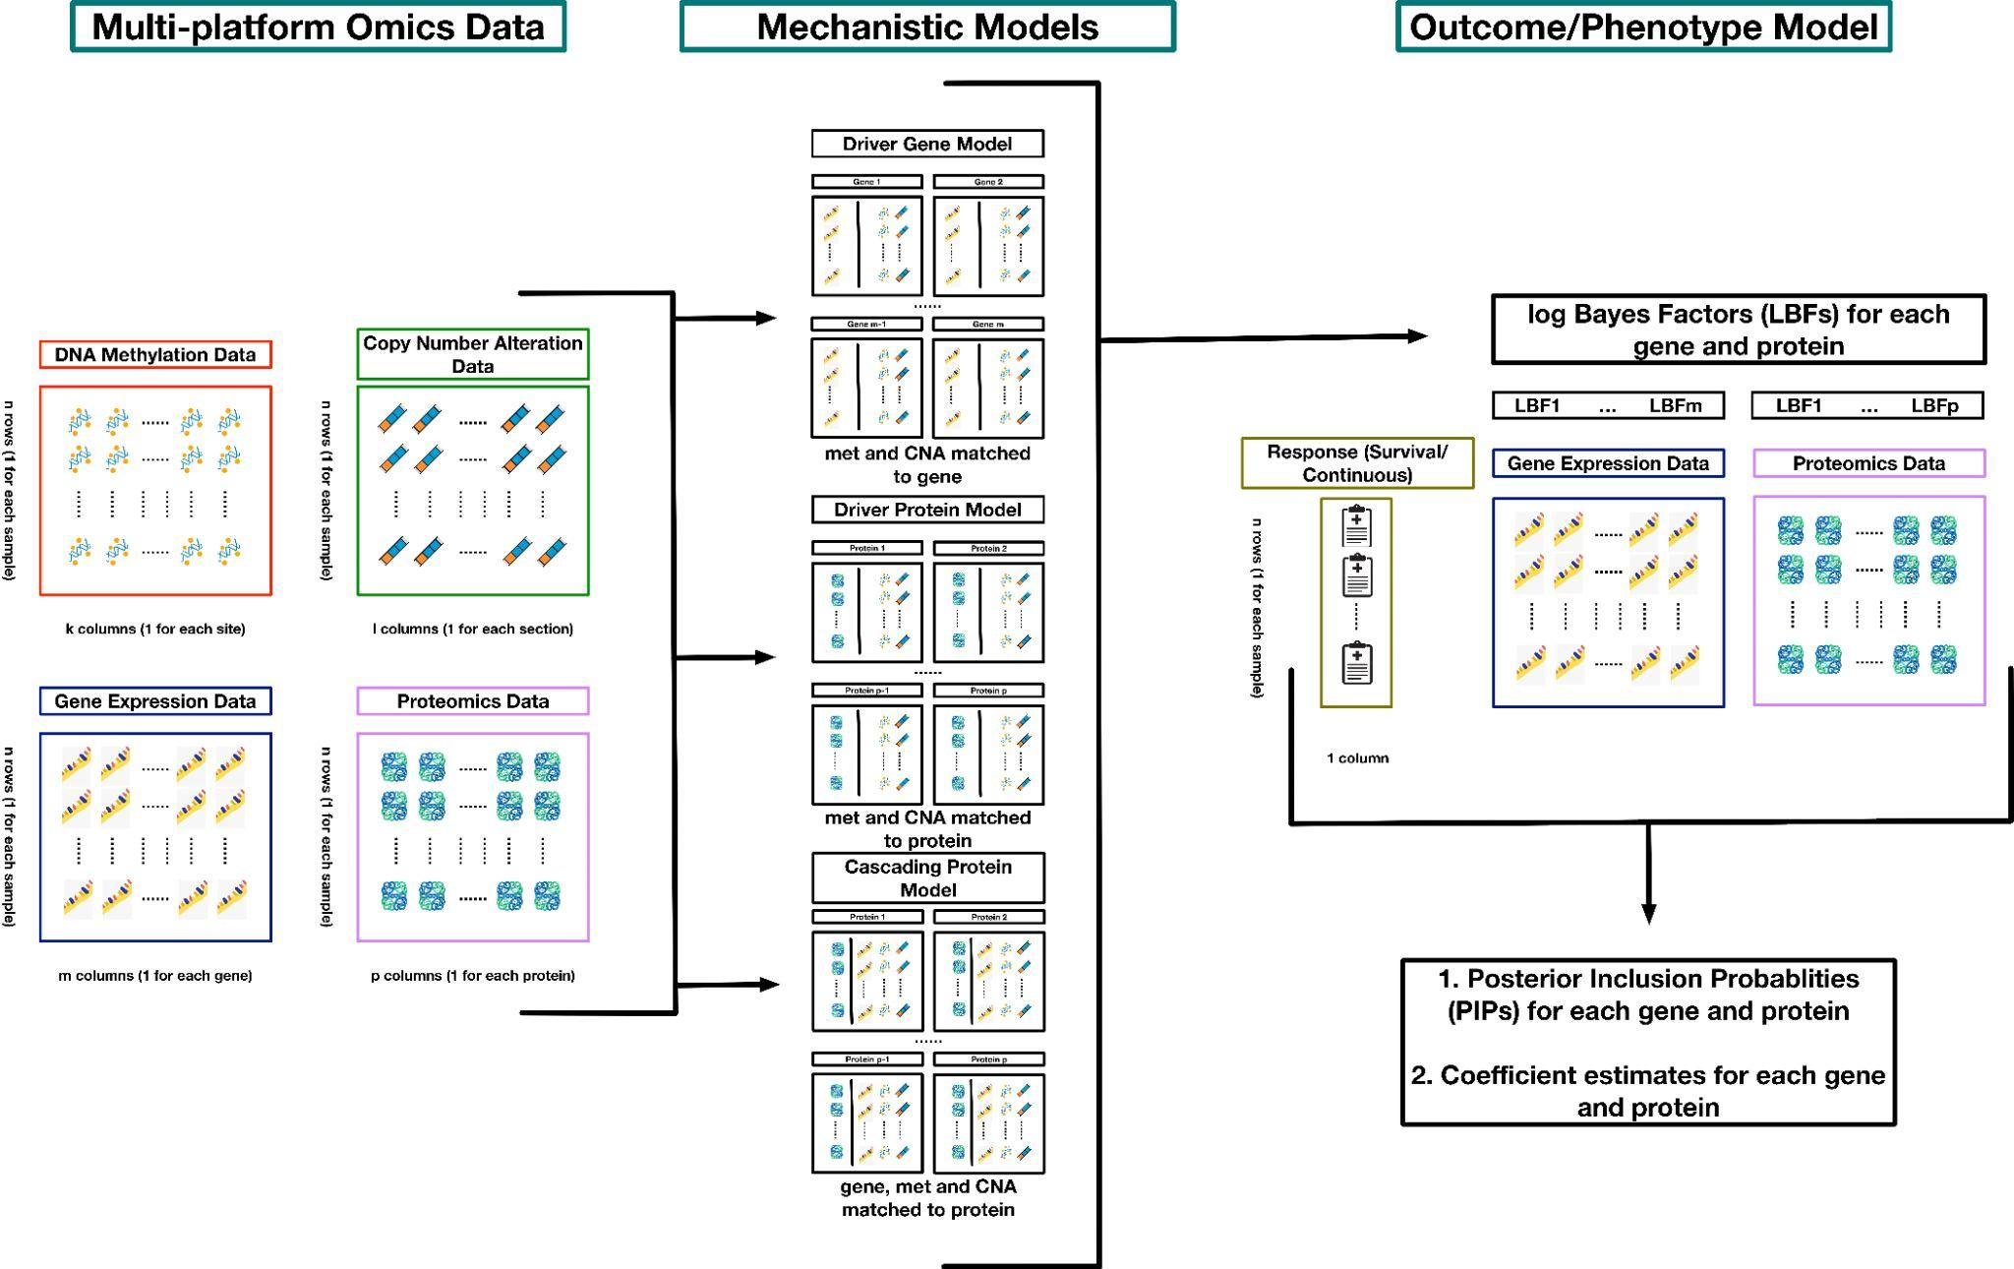
Data Structure

Slide 25
Focus
Mechanistic models only:
Cancer-specific identification of genes and proteins that are functionally relevant.
Pan-cancer identifications of drivers and cascades.
Mechanistic + Stemness models:
Identifying genes/proteins associated with stemness.
Similar questions for Survival models.
Stemness angle:
Scalar quantification of stem-cell-like features.
Stemness indices defined following Malta et al. 2018, Cell.
Models trained on non-transformed pluripotent stem cells.

Slide 26
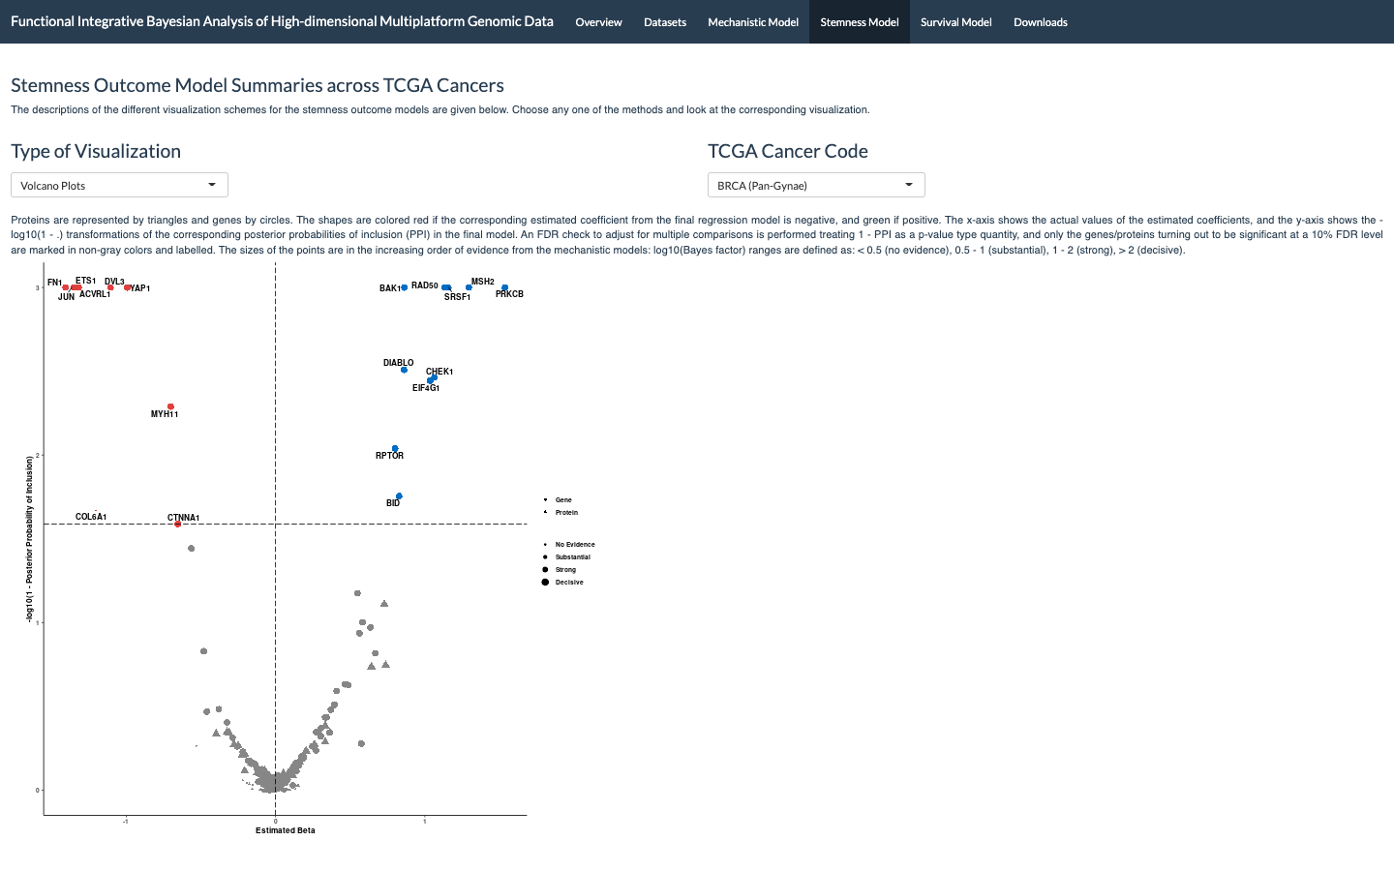
Results Dashboard
https://bayesrx.shinyapps.io/Functional_iBAG/

Slide 27
Interesting Results
RPS6KA1 gene and p90RSK kinases in gynecological cancer progression.
Overactivation of YAP1 gene and YAP proteins in gynecological malignancies.
EGFR protein exhibiting contradictory associations with gastrointestinal cancers.

Slide 28
Wrap-up
Summary:
Calibration has benefits.
MCMC computation is a bottleneck.
Future steps?
Expand the proteomics panel.
Clinical Proteomic Tumor Analysis Consortium (CPTAC).
Incorporate tumor heterogeneity information.
Varying-coefficient models?
Hastie and Tibshirani 1993, JRSSB.
Precision oncology direction?
Cell lines - drug response data in a third layer.

Slide 29
Selected References
Gevaert, O., Villalobos, V., Sikic, B. I., & Plevritis, S. K. (2013). Identification of ovarian cancer driver genes by using module network integration of multi-omics data. Interface focus, 3(4), 20130013.
Malta, T. M., Sokolov, A., Gentles, A. J., Burzykowski, T., Poisson, L., Weinstein, J. N., ... & Schumacher, S. E. (2018). Machine learning identifies stemness features associated with oncogenic dedifferentiation. Cell, 173(2), 338-354.
Ročková, V., & George, E. I. (2014). EMVS: The EM approach to Bayesian variable selection. Journal of the American Statistical Association, 109(506), 828-846.
Song, X., Ji, J., Gleason, K. J., Yang, F., Martignetti, J. A., Chen, L. S., & Wang, P. (2019). Insights into impact of DNA copy number alteration and methylation on the proteogenomic landscape of human ovarian cancer via a multi-omics integrative analysis. Molecular & Cellular Proteomics, 18(8), S52-S65.

Slide 30
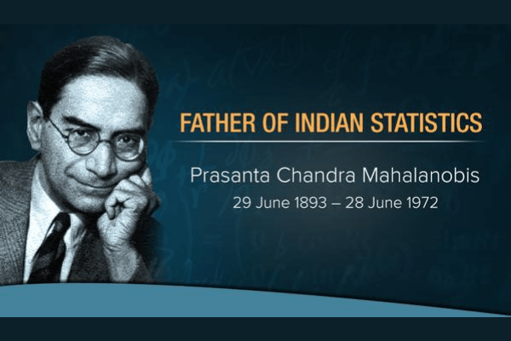

Slide 31
Thanks for your attention!
Questions?
www.rupamb.com
rupamb@umich.edu

